Slide 1
HCI Evaluation Part One
Dr Jon Bird
jon.bird@bristol.ac.uk
Thanks to Stuart Gray, Pete Bennett, Simon Lock, Thomas Bale, Harry Field who developed some of these slides
Images are royalty free from www.pexels.com

Slide 2

Today’s Lecture
What is HCI evaluation?
Why is it important
The Think Aloud evaluation technique
Heuristic evaluation

Slide 3

HCI Evaluation
Evaluation is a crucial part of the user-centred development process – we want to ensure our software meets our users’ requirements
The focus of this lecture is on Think Aloud technique and Heuristic Evaluation, which are two of the most widely used evaluation methods in industry
They are methods that we recommend you carry out on your game as part of your group project – you can write up the results in your report

Slide 4

Why is evaluation important?
“Iterative design, with its repeating cycle of design and testing, is the only validated methodology in existence that will consistently produce successful results. If you don’t have user-testing as an integral part of your design process you are going to throw buckets of money down the drain.”
Bruce Tognazzini (we’ll meet him later in the lecture)

Slide 5

The Think Aloud evaluation technique
Users are asked to verbalise what they are thinking and doing as they perform a task using your software
The Think Aloud technique provides insights into the user experience of using your software
It can identify issues with the software e.g. navigation problems or content that can be improved
It can be used as part of the software development process to iteratively improve software or used with a finished product

Slide 6

Benefits of Think Aloud
Cheap
Relatively easy
It provides insight into people’s experiences as they interact with your product
It can be carried out with low numbers of participants
Fits in with most software development processes

Slide 7
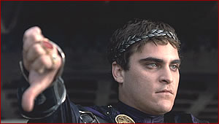
Drawbacks of Think Aloud
it relies on people verbalising thoughts and impressions, rather than objective measures
Participants may say what they believe to be the right answer rather than what they really think (social desirability). This can distort your results and conclusions

Slide 8

Planning a Think Aloud evaluation
Decide what questions you want your study to answer. For example, whether users can find particular content or what their understanding is of the information presented.
Write down the tasks you want the user to complete while using your software
Decide how many participants you want to recruit and how long you want the sessions to last (45 to 90 minutes works well)

Slide 9

Carrying out a Think Aloud evaluation 1
Have a facilitator to run the evaluation and one or two observers to take notes on what the user says
Explain to the participants how a think aloud works: they should tell you their thoughts, reactions and emotions as they occur while they are performing the task
Explain that there is no right answer and it’s fine to be critical

Slide 10

Carrying out a Think Aloud evaluation 2
Ask the participants to complete the tasks you have planned. This should be uninterrupted as far as possible, although the facilitator will probably need to give some prompts.
If the user goes silent then prompt them to verbalise their thoughts by saying “what are you thinking”

Slide 11

Analysing a Think Aloud evaluation
Put the written notes together from both observes in to one document
Organise the notes into meaningful categories e.g. what features helped users; what features led to problems; any additional features that users wanted.
You can make your own meangingul categories
Count the number of times users comment about different categories to identify the biggest issues

Slide 12

Jakob Nielsen – heuristic evaluation
Nielsen, J., and Molich, R. (1990). Heuristic evaluation of user interfaces, CHI'90, 249-256.
https://www.nngroup.com/articles/how-to-conduct-a-heuristic-evaluation/

Slide 13

Nielsen Norman group http://www.nngroup.com/
The Nielsen Norman group is a UX research and consulting firm
It was founded by two big figures in the HCI world:
Don Norman coined the term “user experience” and developed a set of design heuristics
Jakob Nielsen also developed a set of usability heuristics and was a pioneer of heuristic evaluation

Slide 14

What is a heuristic?
A rule of thumb
Experienced-based strategies
E.g. if you’re doing some DIY then ‘measure twice, cut once’ is a useful heuristic

Slide 15

Heuristic evaluation 1
An evaluation technique conducted without users
Also known as expert evaluation as it’s sometimes carried out by external experts (sometimes by the development team) aka evaluators
It’s a type of analytical evaluation, that is, based on a set of principles or a model…
…rather than by observing users (which is known as empirical evaluation)

Slide 16

Heuristic evaluation 2
It’s an inspection method – it involves inspecting a design to find usability problems
This involves asking whether the design complies with usability principles (a set of heuristics)

Slide 17
Heuristic evaluation is widely used because…
It’s cheap (only needs a small number of evaluators and no specialist equipment or labs)
Relatively easy to carry out (can do it after a few hours of training)
Instant gratification – lists of problems are available immediately after the inspection
It fits in with most software development processes used in industry
It’s a very cost effective: benefit-cost ratio of 48: cost of $10,500; expected benefits $500,000 (Nielsen 1994).

Slide 18

Where are the users?
Heuristic evaluation is based on HCI researchers’ extensive experience of designing and evaluating interfaces
By focusing on users, HCI researchers learned what works and what doesn’t
Their experience is distilled into usability principles (a set of heuristics)
The principles represent the findings from thousands of user studies
They have been used for over 30 years

Slide 19
What are Nielsen’s 10 principles of heuristic evaluation?
visibility of system status
match between system and real world
user control and freedom
consistency and standards
error prevention
recognition rather than recall
flexibility and efficiency of use
aesthetic and minimalist design
help users recognise, diagnose and recover from errors
help and documentation

Slide 20
Nielsen’s 10 principles of heuristic evaluation (minimal information)
feedback
metaphor
user control and freedom
consistency
error prevention
recognition not recall
flexible use
minimal information
error recognition and recovery
help

Slide 21

Visibility of system status - feedback
Inform the user about what’s going on:
show appropriate feedback and progress
do not show blank screens
do not show static “load” or progress messages

Slide 22
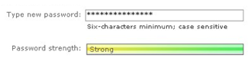
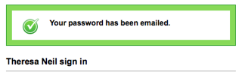
Visibility of system status: examples
Microsoft Live Password strength is shown as the password is entered. Colors are used to augment the message.
Tick A feedback message is displayed when an action is performed

Slide 23
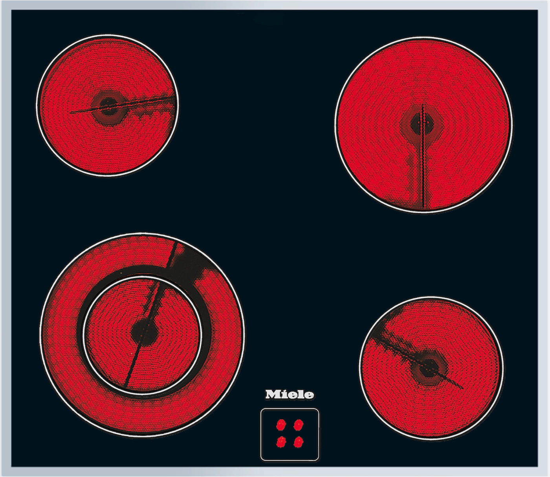
Match between system and real world - metaphor
There must be a match between the system’s interface controls and the real world
The system should speak the users’ language, with words, phrases and concepts familiar to the user, rather than system-oriented terms
Follow real-world conventions, making information appear in a natural and logical order

Slide 24
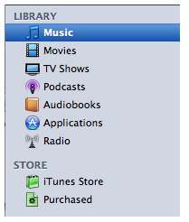
Match between system and real world - examples
iTunes Organized as a library that contains your media library: music, movies, TV shows, audiobooks. Beneath the Library is the Store where you can buy more media to put in your Library.

Slide 25

User control and freedom - navigation
Users often choose system functions by mistake and will need a clearly marked “emergency exit” to leave the unwanted state without having to go through an extended dialog.
Support undo and redo and a clear way to navigate.
Provide bread crumbs to clearly show where the user is.

Slide 26
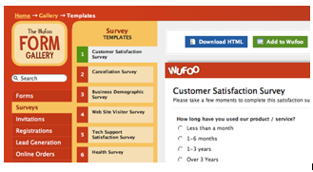
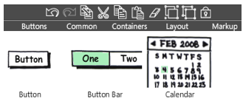
User control and freedom - examples
Wufoo Clearly marks where the person is and where they can go by showing the selection in each menu
Balsamiq Undo and Redo buttons are available in the toolbar, and can also be accessed with the standard keyboard shortcuts

Slide 27

Consistency and standards
Users should not have to wonder whether different words, situations, or actions mean the same thing.
Follow platform conventions.

Slide 28
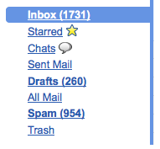
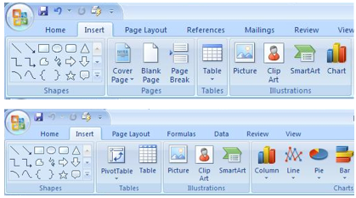
Consistency: examples
Gmail When Gmail was designed, they based the organizational folders on the same ones used in other client email applications: Inbox, Drafts, Sent Mail.
Microsoft Office Word, Excel, and PowerPoint all use the same style toolbar with the same primary menu options: Home, Insert, Page Layout.

Slide 29

Error prevention
Even better than good error messages is a careful design which prevents a problem from occurring in the first place.
Either eliminate error-prone conditions or check for them and present users with a confirmation option before they commit to the action.

Slide 30
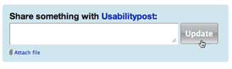

Error prevention: examples
Yammer Disables the update button after it is clicked, so the person cannot update the post twice by accident
Example from “Web form Design:Filling in the Blanks” by Luke W. Make the primary action prominent with a larger click area. Cancel and other secondary actions are just shown as links

Slide 31

Recognition rather than recall
Minimize the user’s memory load.
Make objects, actions, and options visible.
The user should not have to remember information from one part of the dialogue to another.
Instructions for use of the system should be visible or easily retrievable whenever appropriate.

Slide 32
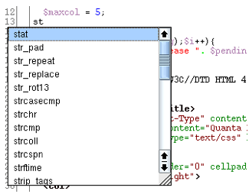
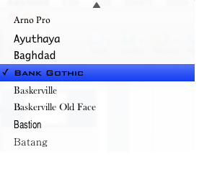
Recognition: examples
Quanta IDE Auto completion for coding in a development environment
Keynote Previews the fonts you can pick from, instead of just the font name

Slide 33
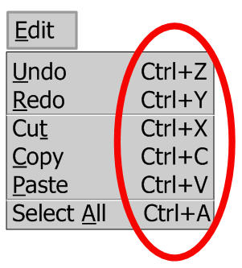
Flexibility and efficiency of use
Accelerators — unseen by the novice user — may often speed up the interaction for the expert user so that the system can cater to both inexperienced and experienced users
Allow users to tailor frequent actions

Slide 34
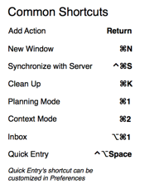
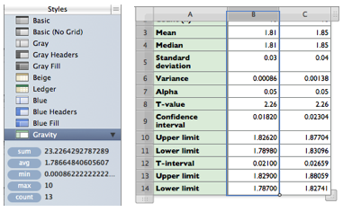
Flexibility and efficiency: examples
Numbers by Apple Previews common function results on the left when a column is selected, more efficient than clicking on an action in the toolbar
OmniFocus List of keyboard shortcuts and accelerators

Slide 35

Aesthetic and minimalist design
Dialogues should not contain information which is irrelevant or rarely needed
Every extra unit of information in a dialogue competes with the relevant units of information and diminishes their relative visibility
Visual layout should respect the principles of contrast, repetition, alignment, and proximity.

Slide 36
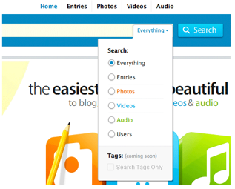
Aesthetics: example
Kontain’s search menu exemplifies the four principles of visual design:
Contrast: bold text is used for the two labels in the search
Repetition: the orange, blue, and green text match the media types
Alignment : strong left alignment of text, right aligned drop down
Proximity: a light rule is used to separate tags from the other options

Slide 37
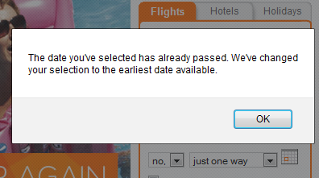
Help users recognise, diagnose and recover from errors
Help users recognize, diagnose, and recover from errors.
Error messages should be expressed in plain language (no jargon), precisely indicate the problem, and constructively suggest a solution.

Slide 38
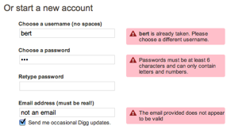
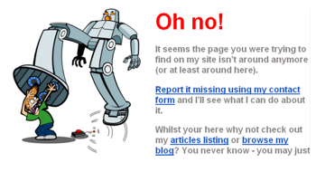
Error recognition and recovery: examples
Digg Provides immediate feedback with specific instructions
Humorous ‘ Page Not Found’ Error Uses a funny image and text, but provides viable alternatives (article listings and blog link) and a course of action (report it)

Slide 39
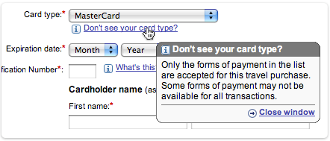
Help and documentation
Even though it is better if software can be used without documentation, it may be necessary to provide help and documentation.
Any such information should be contextual, easy to search, focused on the user’s task, list concrete steps to be carried out, and not be too large.

Slide 40

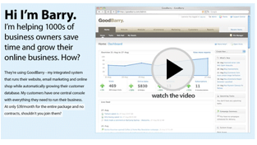
Help and documentation: examples
Picnik Contextual tips in Picnik are clear and easy to navigate
GoodBarry Embedded videos can be used to showcase features as well as get people started using the product

Slide 41
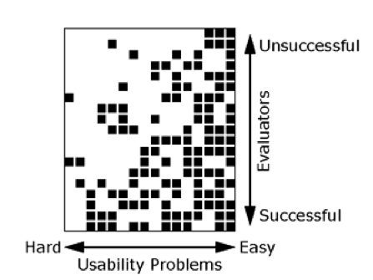
How many evaluators are needed for heuristic evaluation?

Slide 42
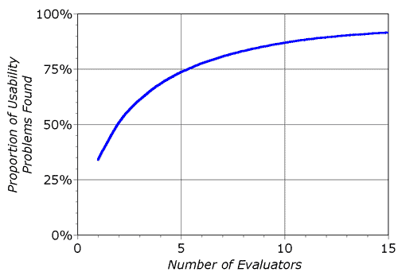
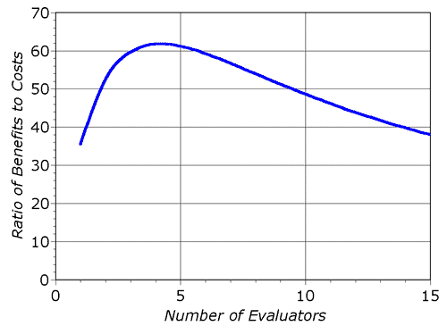
Practical considerations

Slide 43
How to run a heuristic evaluation 1
Each of the 3 – 5 evaluators does a heuristic evaluation of an interface alone
Sometimes a facilitator can record the evaluator’s comments, sometimes the evaluator does it
A facilitator can answer evaluators’ questions, in contrast to traditional user testing, particularly if it’s not a walk up and use system
Heuristic evaluation can be done on paper prototypes

Slide 44

How to run a heuristic evaluation 2
Heuristic evaluations typically last 1 – 2 hours, but it does depend on the complexity of the software
The expert goes through the interface several times – first time to get a feel for the system, second time to focus on specific elements
Evaluators can be given scenarios that describe typical usage scenarios (built from a task analysis of users)
Evaluators produce a list of usability problems: the usability principle and the design feature that violated it

Slide 45
Benefits of heuristic evaluation
Cheap
Relatively easy
Instant gratification lists of problems are available immediately after the inspection
It can be carried out with low numbers of participants
Fits in with most software development processes
Cost effective

Slide 46
Drawbacks of heuristic evaluation
Important issues may get missed
Might identify false issues
Many trivial issues are often identified, making it seem overly critical
Experts have biases

Slide 47

Reading
Interaction Design: Beyond Human-Computer Interaction covers all HCI evaluation techniques. It's available through the university library as an eBook. Read about the evaluation techniques covered in this lecture to deepen your understanding
Read the original Nielsen paper on heuristic evaluation: https://www.nngroup.com/articles/how-to-conduct-a-heuristic-evaluation/

Slide 48

Reading 2
Explore the materials (papers, articles and videos) on heuristic evaluation on the Nielsen Norman group website:
https://www.nngroup.com/articles/ten-usability-heuristics/

Slide 49


Before the workshop today
Please review the lecture materials on the Think Aloud and Heuristic Evaluation techniques
Your workshop activities will involve evaluating your games using these two techniques

